Slide 1
ECOMMERCE ON FASHION TRADING

Slide 2
MENTOR Rajashekar
Project: 102
Group:-5
Members:
Dr.Bharti Mittal
Aswin
Gokul CT
Nekkalapu Saikumar
Marripudi Saikumar
Om Mourya

Slide 3
E-commerce domain
E-commerce or electronic commerce is a process of Buying , selling , transferring , or exchanging products , services , and/or information via electronic networks and computers

Slide 4
Business applications
Email
Online shopping and order tracking
Online banking
Shopping cart software
Teleconferencing
Electronic tickets

Slide 5
Examples of E-Commerce
Amazon.
Flipkart.
eBay.
Fiverr.
Upwork.
Olx.
Quikr.

Slide 6
Advantages of ecommerce shopping
Lower price
Time saving
Avoiding crowds
Wide range and verity of products
Feedback option
shipping/delivery

Slide 7
Business problem: Interpret which variables are contributing towards the more annual income prediction
What is a company's annual income?
The annual income of a company is the total money it earns from its business operation during one financial year. You can calculate the annual income by adding the following components:
Income from selling products or services
Capital gains from selling the shares of the company
Income from selling surplus equipment or property of the company
Income from interest or fees levied on the company's intellectual property

Slide 8
E-Commerce Revenue Models
Revenue models
affiliate marketing.
online advertising.
transaction fees.
subscription based services.
product and information sales.

Slide 9
Exploratory data analysis
Exploratory Data Analysis (EDA) is an approach to analyse the data using visual techniques. It is used to discover trends, patterns, or to check assumptions with the help of statistical summary and graphical representations.

Slide 10
Business problem
A project with an Ecommerce company based in London sells clothing online but they also have in-store style and clothing advice sessions. Customers come in to the store, have sessions/meetings with a personal stylist, then they can go home and order either on a mobile app or website for the clothes they want.
The company is trying to decide whether to focus their efforts on their mobile app experience or their website. They've asked to help them figure it out.
We worked with the Ecommerce Customers csv file from the company. It has Customer info, such as Email, Address, and their colour Avatar. Then it also has numerical value columns:
Avg. Session Length: Average session of in-store style advice sessions.
Time on App: Average time spent on App in minutes
Time on Website: Average time spent on Website in minutes
Length of Membership: How many years the customer has been a member.
Yearly Amount Spent: The total amount the customer is spending.
>Business problem: Interpret which variables are contributing towards the more annual income prediction

Slide 11
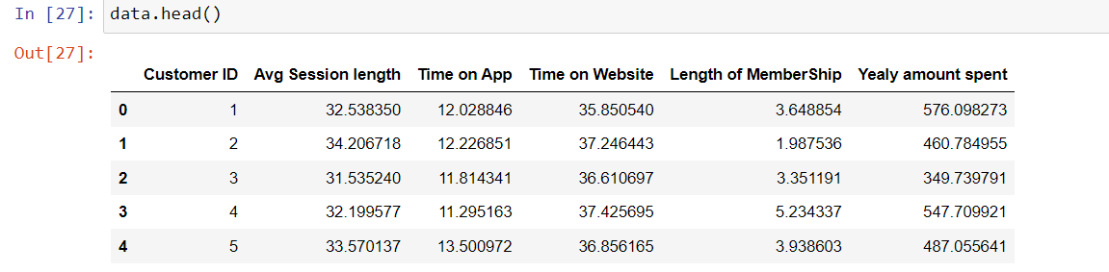
Sample data

Slide 12
Data preparation
Data cleaning:- cleaning of data by checking for null values/missing values (if we have null values we need to impute mean,median or mode values)
checking for duplicates and conversion of data types
Feature engineering :- elimination of unwanted features , feature addition(if needed) and feature transformation
Data transformation :- we need to transform the data to get good model(with low errors)

Slide 13
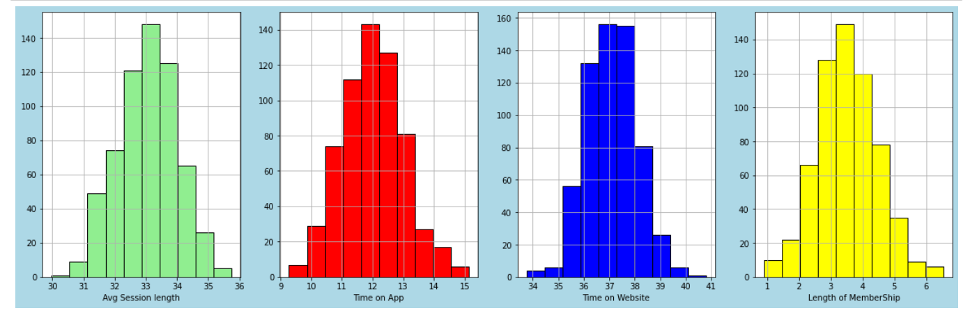
Normality testing we checked the normality by using the histogram and found that features are normally distributed

Slide 14
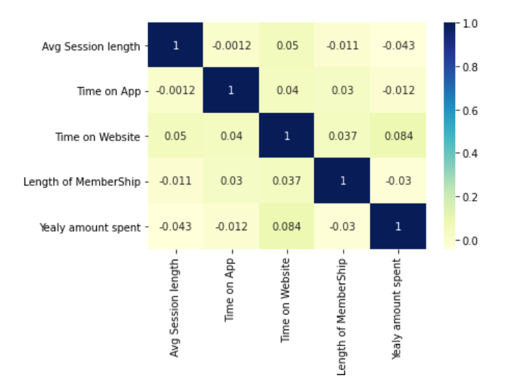
Multicollinearity test with the help of heat map we found out that features are not too internally correlated each other

Slide 15
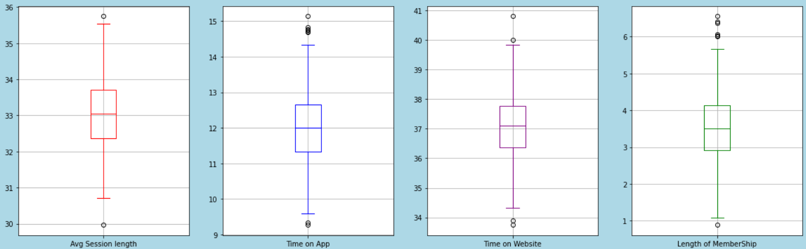
Checking for outliers we use boxplots for outlier detection and found out the there are some outliers but the data is normally distributed so no need to treat outliers.

Slide 16
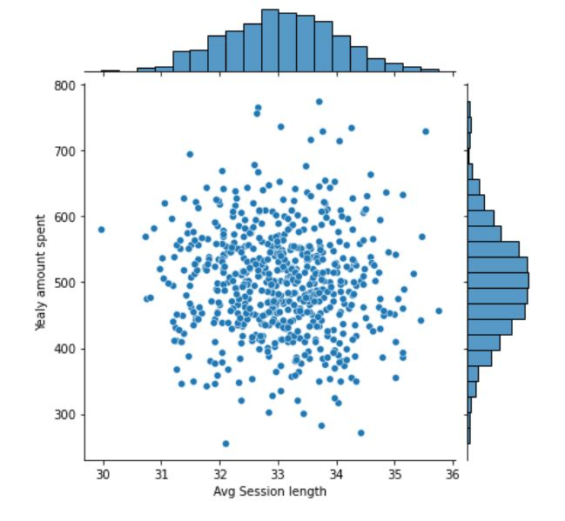
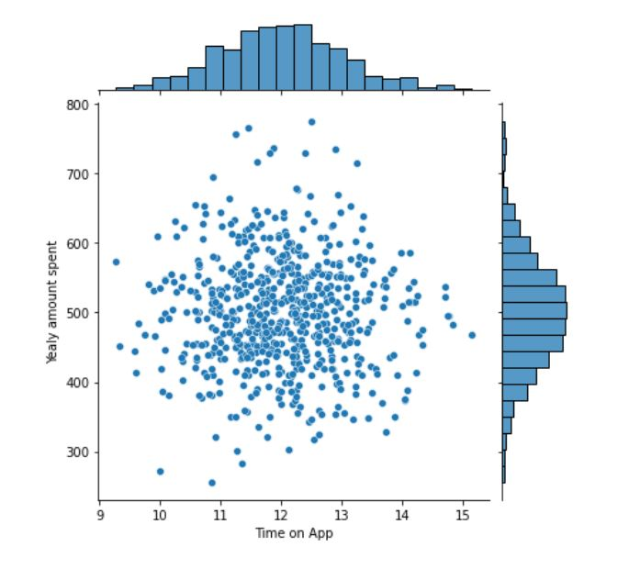
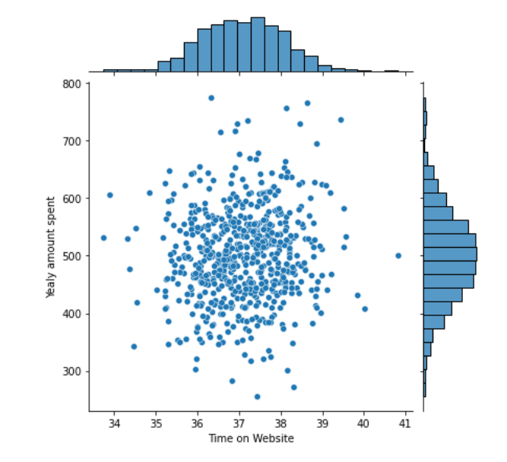
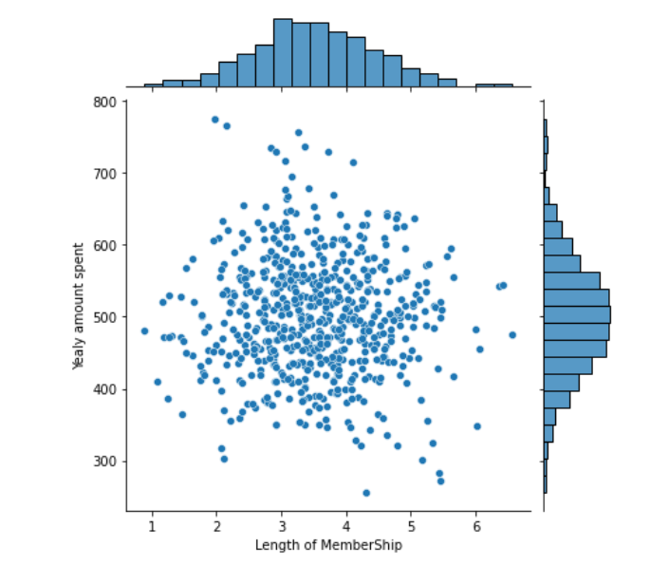
Checking for relationship we use jointplot to check the relationship between features and target variable, and there is no patterns visible so there is no stronger relationships.

Slide 17
Model Building
Linear regression
Decision tree
Bagging regressor
Random forest regressor
Svm regressor
Lasso regression
Ridge regression
Elasticnet regression

Slide 18
Model creation and prediction
we have splited the data into x (features) & y(target variable)
Then we splited the data into train and test values with 20% test size & random state=20
Then we have created model and fitted with train values and predicted with x test values
Then found the error values(mae & mape) with predicted and y test values
We use model.feature_importances_ to find the importance of features.

Slide 19
Models and errors
models | mae | mape
Linear regression | 65.170 | 0.129835
Decision tree | 86.368 | 0.189067
Bagging regressor | 76.911 | 0.168754
Random forest regressor | 72.676 | 0.160942
Svm regressor | 64.495 | 0.128887
Lasso regression | 65.165 | 0.129851
Ridge regression | 65.168 | 0.129832
Elasticnet regression | 64.960 | 0.129434

Slide 20
Models and errors after outlier treatment
models | mae | mape
Linear regression | 65.159 | 0.129855
Decision tree | 87.262 | 0.190057
Bagging regressor | 73.162 | 0.161261
Random forest regressor | 72.921 | 0.161678
Svm regressor | 64.473 | 0.128841
Lasso regression | 65.160 | 0.129881
Ridge regression | 65.158 | 0.129853
Elasticnet regression | 64.936 | 0.129442

Slide 21
Model and errors after log transformation
models | mae | mape
Linear regression | 0.13498 | 0.02174
Decision tree | 0.18081 | 0.02939
Bagging regressor | 0.15489 | 0.02528
Random forest regressor | 0.15358 | 0.02511
Svm regressor | 0.13308 | 0.02142
Lasso regression | 0.13372 | 0.02154
Ridge regression | 0.13395 | 0.02158
Elasticnet regression | 0.13372 | 0.02154

Slide 22
Feature importance
We use random forest regressor to find the importance of the features
And we use the –model.feauture_importances_ code to find the importance
Result
features | importances
Avg session length | 24.8%
Time on app | 23.9%
Time on website | 24.5%
Length of membership | 26.5%

Slide 23
Conclusion
with the help of random forest regressor we found out that the most important feature is length of membership .
based on our business problem we are concluding that ‘time on website’ is contributing more towards the annual income than ‘time on app’ .
So the company should give more focus on ‘time on website’ than ‘time on app’ .

Slide 24
Deployment
Our best model to deploy within these models is svm regression model
We have used streamlit to deploy the model
We have created a streamlit webpage to predict the annual income with the best model we have.

Slide 25
THANK YOU

